Slide 1
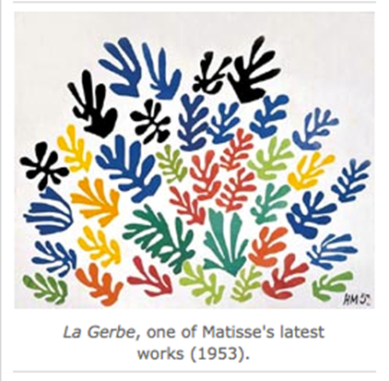
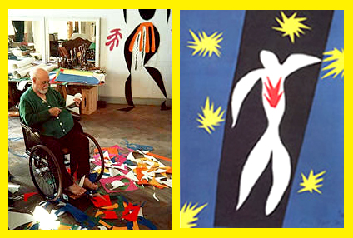
Henri Matisse
December 31, 1869 - November 3, 1954
France
In 1889, Henri became sick. His mother got him some art supplies to keep him busy. He fell in love with painting and art. Henri decided to become an artist.
www.oneschoolroom.ca/henri-matisse/

